Slide 1


Ian Barker
Developer Advocate

Slide 2

Celebrity makeover

Slide 3
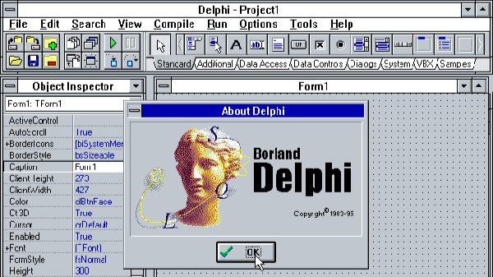
Things have changed a little

Slide 4
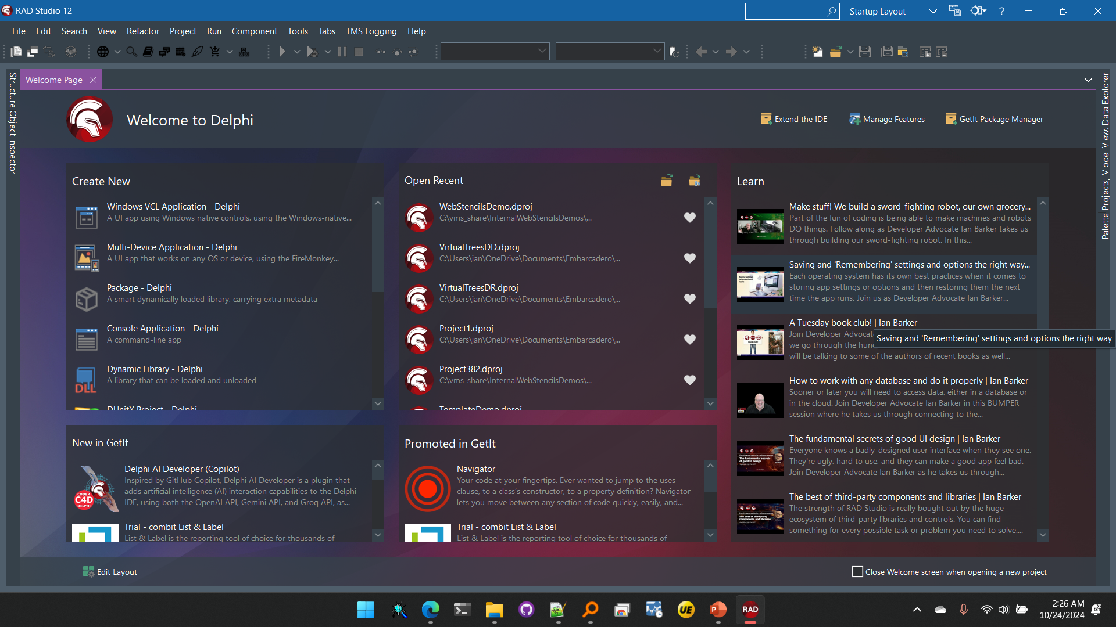
Things have changed a little

Slide 5
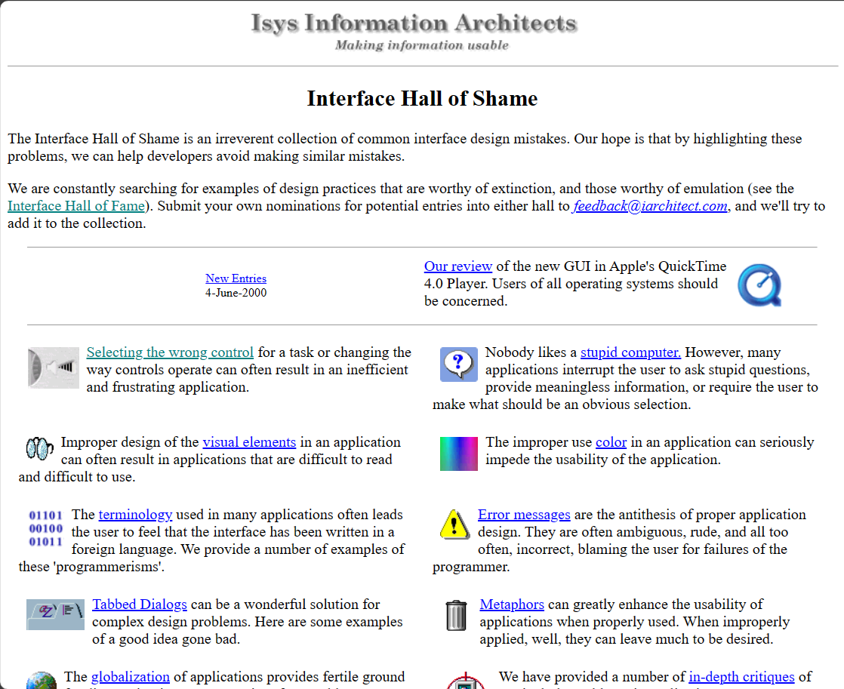
What not to do
The Interface Hall Of Shame
hallofshame.gp.co.at/shame.htm
A very OLD website but it still contains some excellent advice and examples of what you should not do!

Slide 6
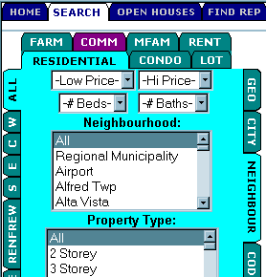
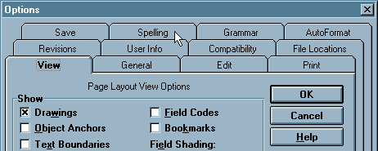
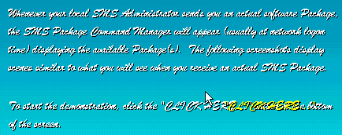

What not to do
The Interface Hall Of Shame
hallofshame.gp.co.at/shame.htm

Slide 7
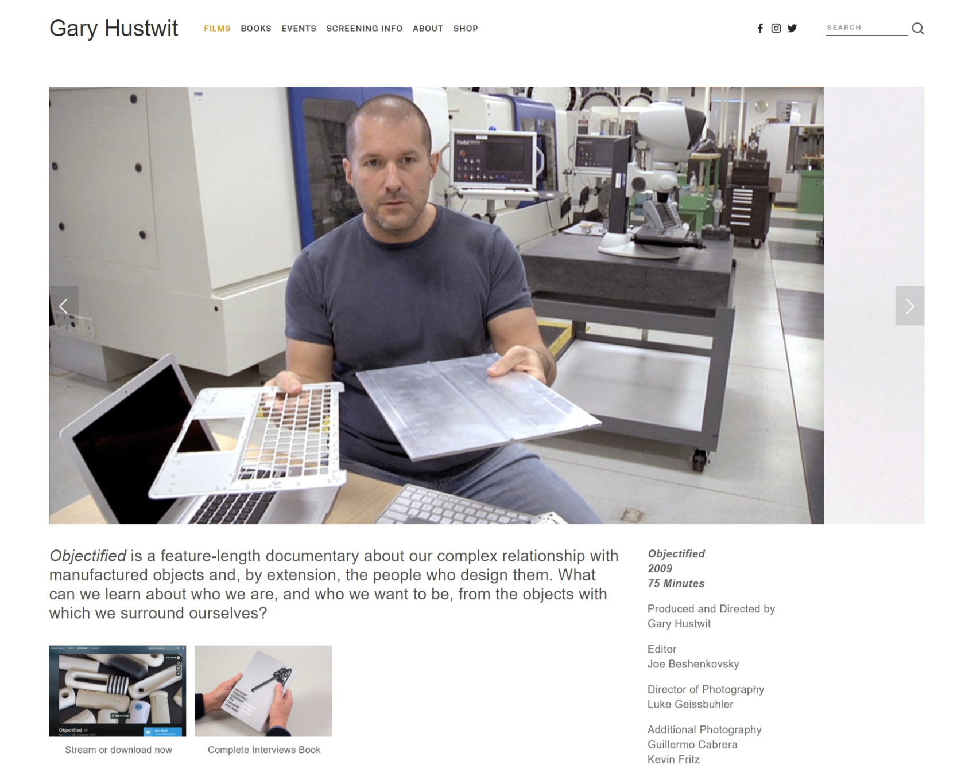
First, seek inspiration…
Objectified
hustwit.com/objectified
Probably the best 75 minutes you can ever spend learning about design
Notes:
Also from Gary Hustwit is Helvetica and Rams (all about Dieter Rams)

Slide 8

The strength of RAD Studio is how much work you don’t have to do
30 lines of code
Drag and drop creation of user interfaces
1000s of ready-made pre-packaged components covering everying you can dream of

Slide 9
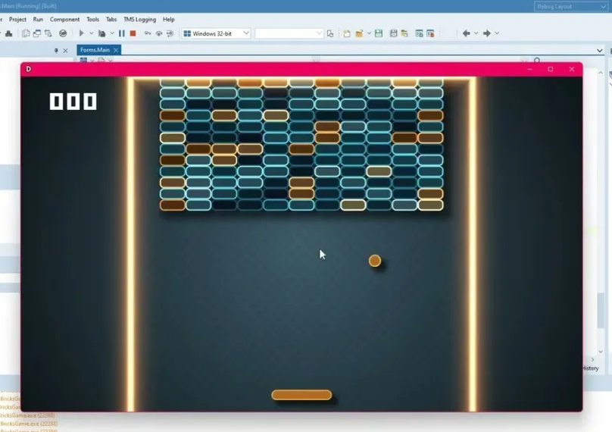
The strength of RAD Studio is how much work you don’t have to do
100 lines of code
Cross-platform: Windows, macOS, iOS, Android
ALL from the same source code with no changes

Slide 10




Videos
A UI/UX YouTube playlist
tinyurl.com/UIPlaylistIanB
With a few videos from previous UI webinars

Slide 11
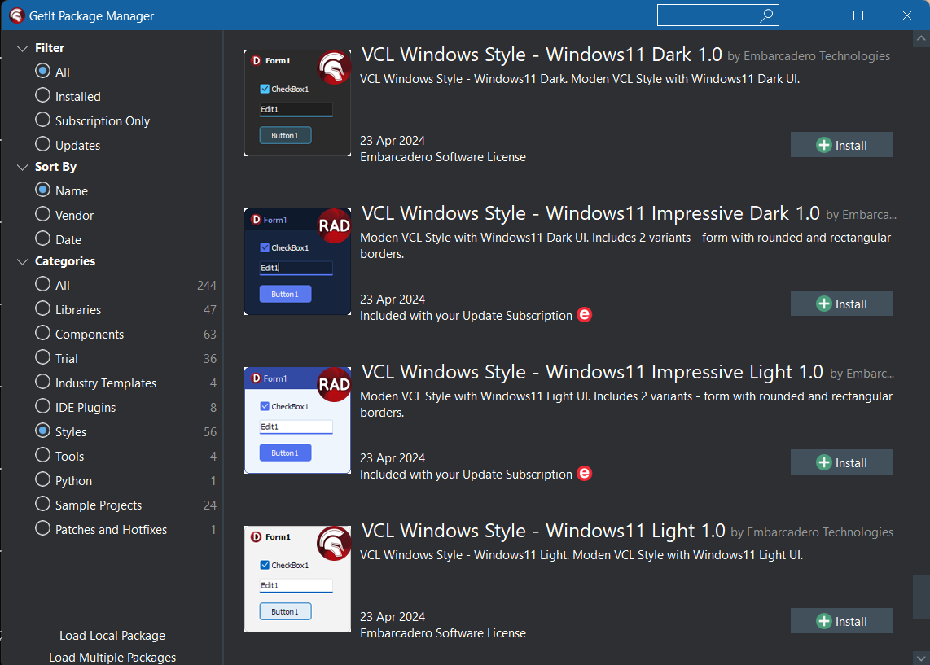

General tips
Support dark mode
github.com/checkdigits/delphidarkmode
Use the dark / light styles from GetIt and the DelphiDarkMode unit to automatically support them

Slide 12
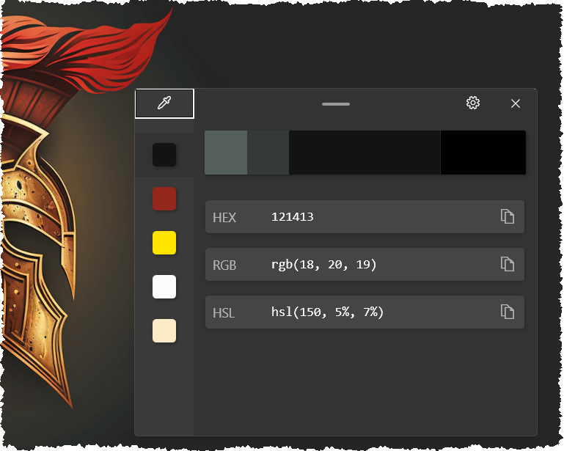
Essential tools
MS Powertoys
https://aka.ms/installpowertoys
For the color-picker tool

Slide 13
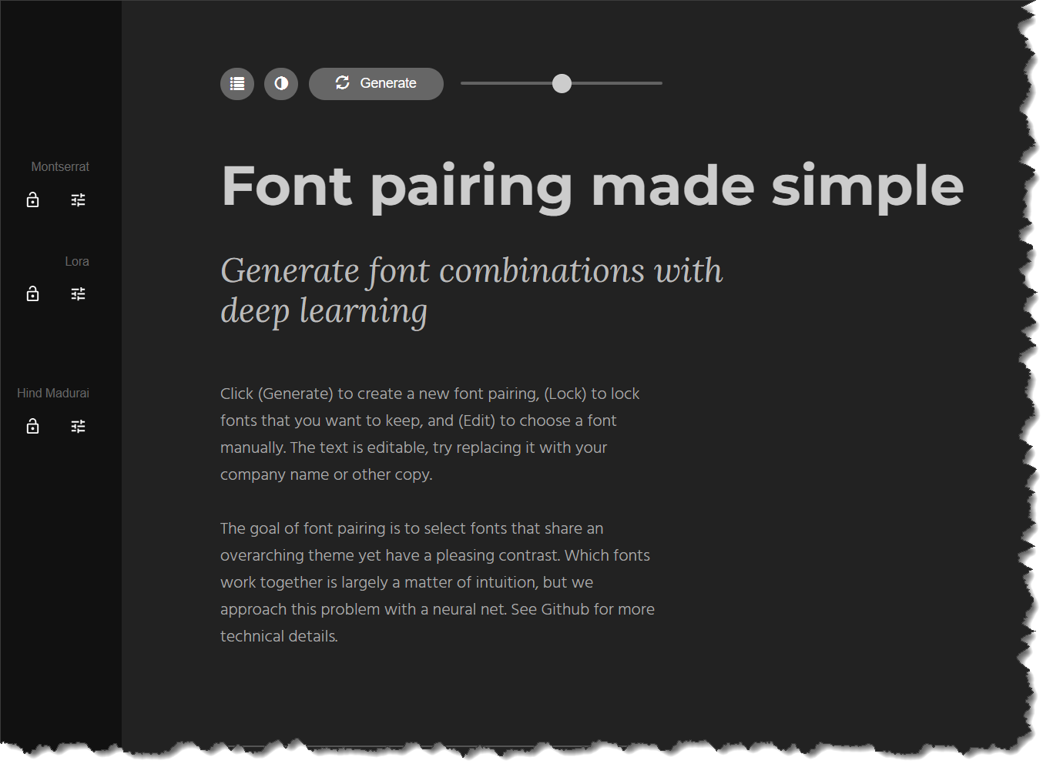
Essential tools
Fontjoy
fontjoy.com
A superb tool for picking good combinations of fonts

Slide 14

Essential reading
The Design of Everyday Things
wikipedia.org/wiki/The_Design_of_Everyday_Things
By Don Norman, the godfather of usability design and psychology
Notes:
Learn what a Norman door is, understand what we mean by affordance

Slide 15

Essential reading
Don’t Make Me Think
sensible.com/dont-make-me-think
From Steve Krug

Slide 16
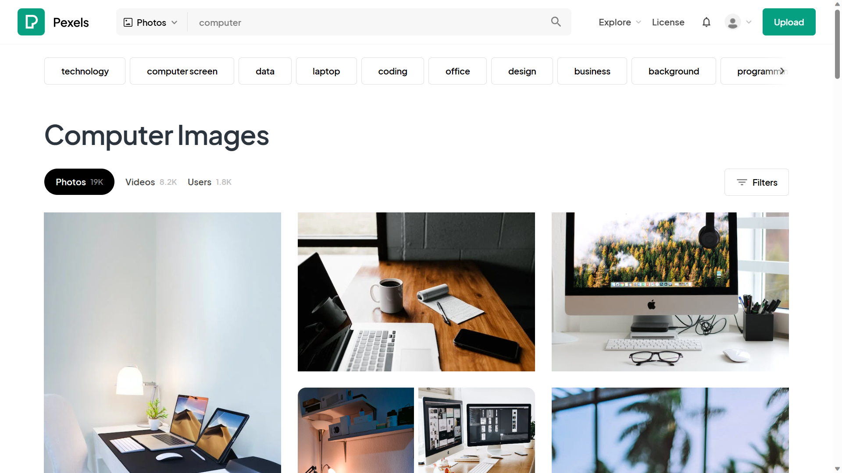
Ready-made things to make you look good
www.pexels.com
Completely FREE graphics of all types

Slide 17
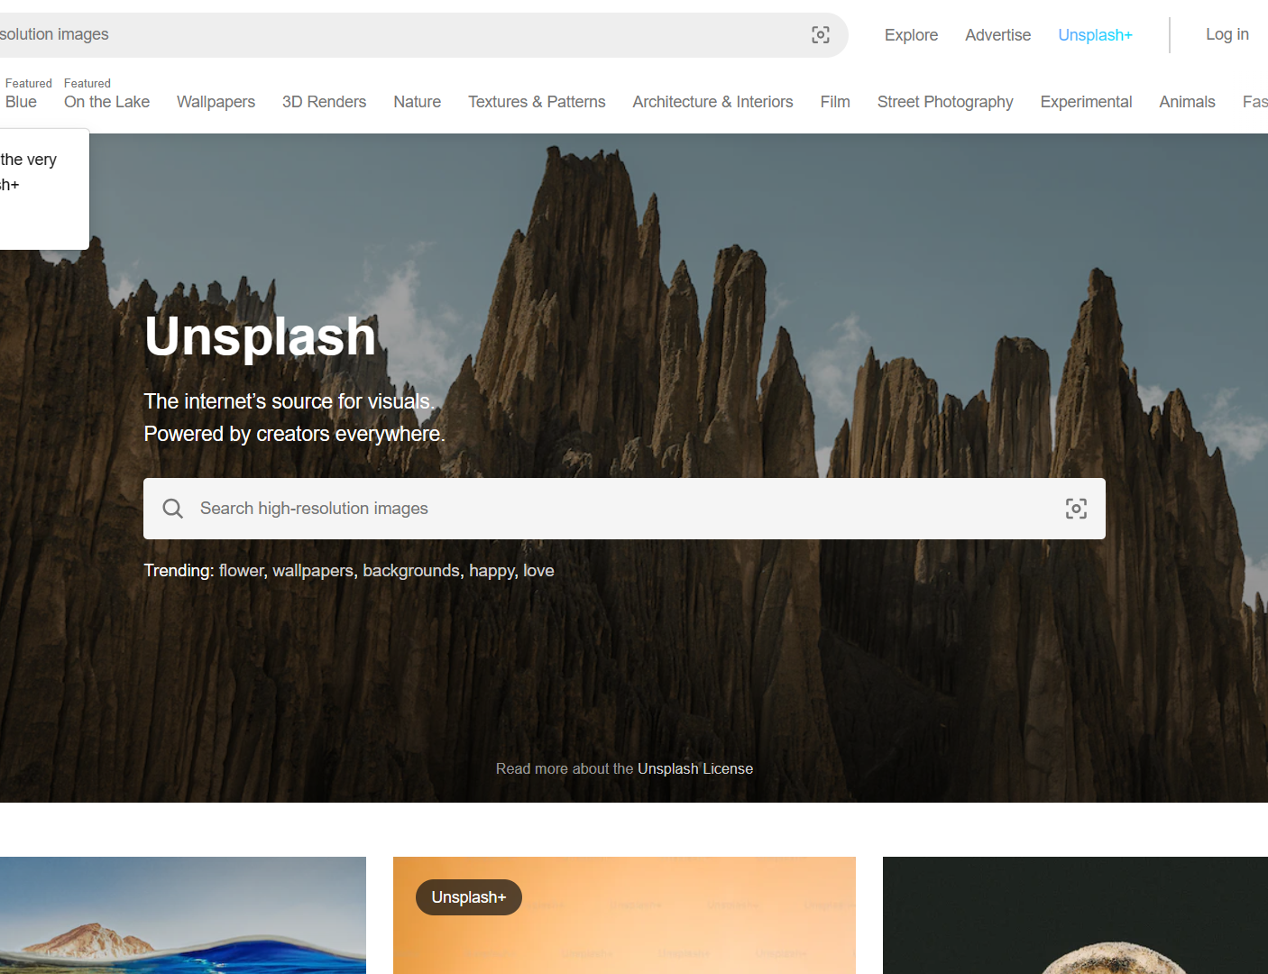
Ready-made things to make you look good
www.unsplash.com
More FREE larger format graphics of all types

Slide 18
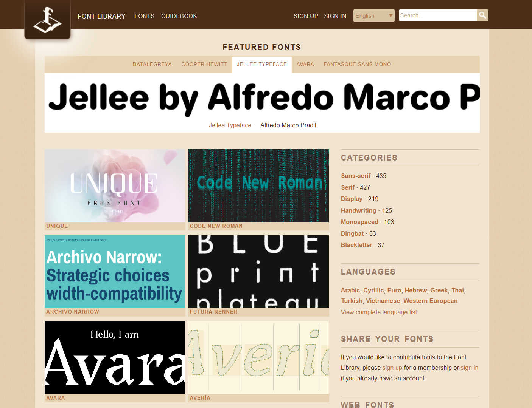
Ready-made things to make you look good
fontlibrary.org
HUGE range of free fonts of every kind

Slide 19
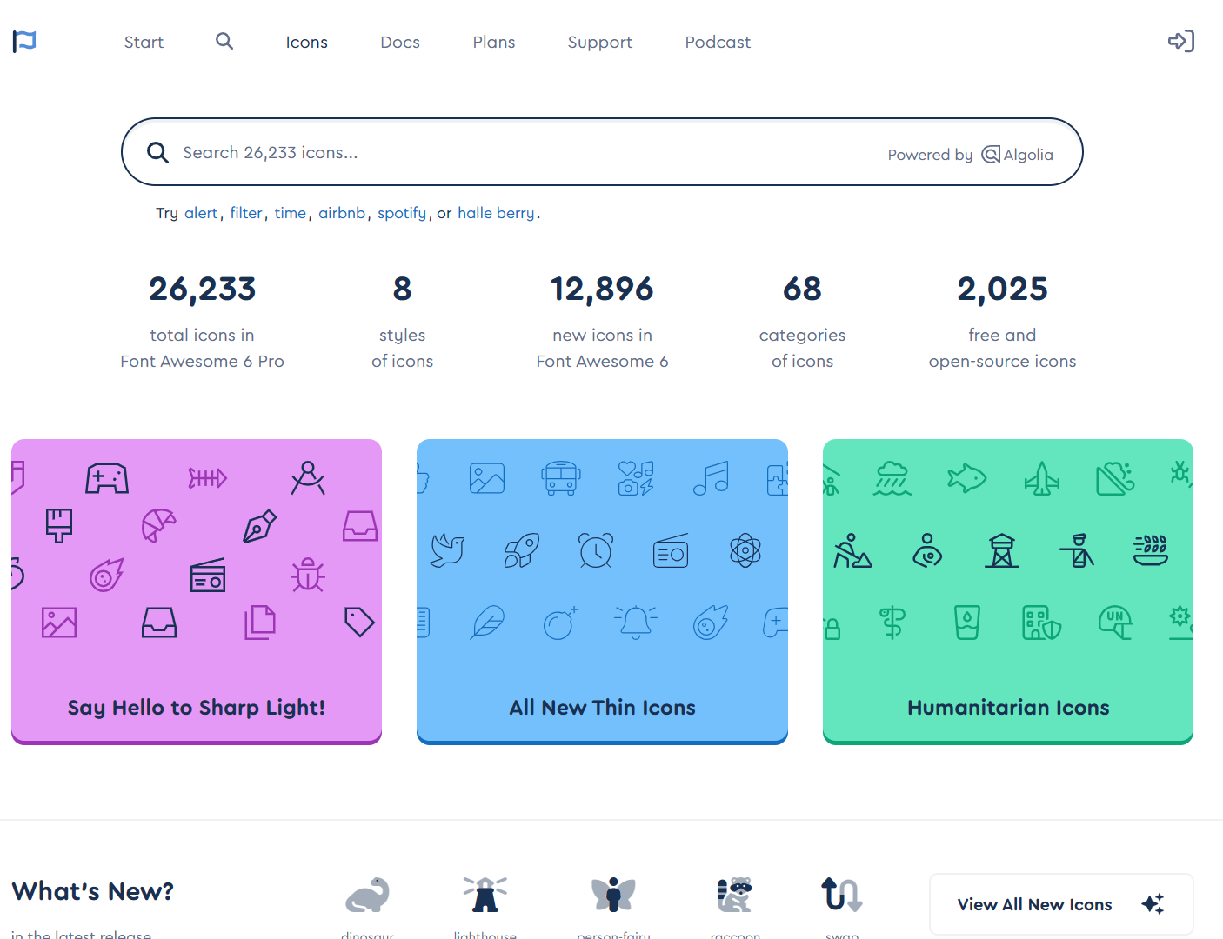
Ready-made things to make you look good
fontawesome.com
The definitive source for all those cool line drawing icons you see EVERYWHERE

Slide 20

Ready-made things to make you look good
lottiefiles.com
A whole bunch of cartoon-like animations

Slide 21
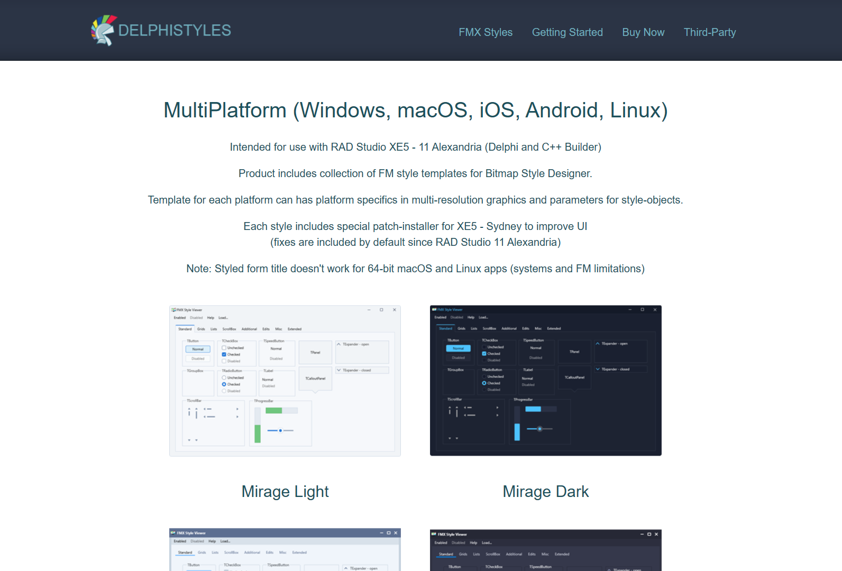
Ready-made things to make you look good
www.delphistyles.com
Make your apps look like you have a whole team of expensive designers locked in your bathroom

Slide 22
Ian Barker
Developer Advocate

